Slide 1
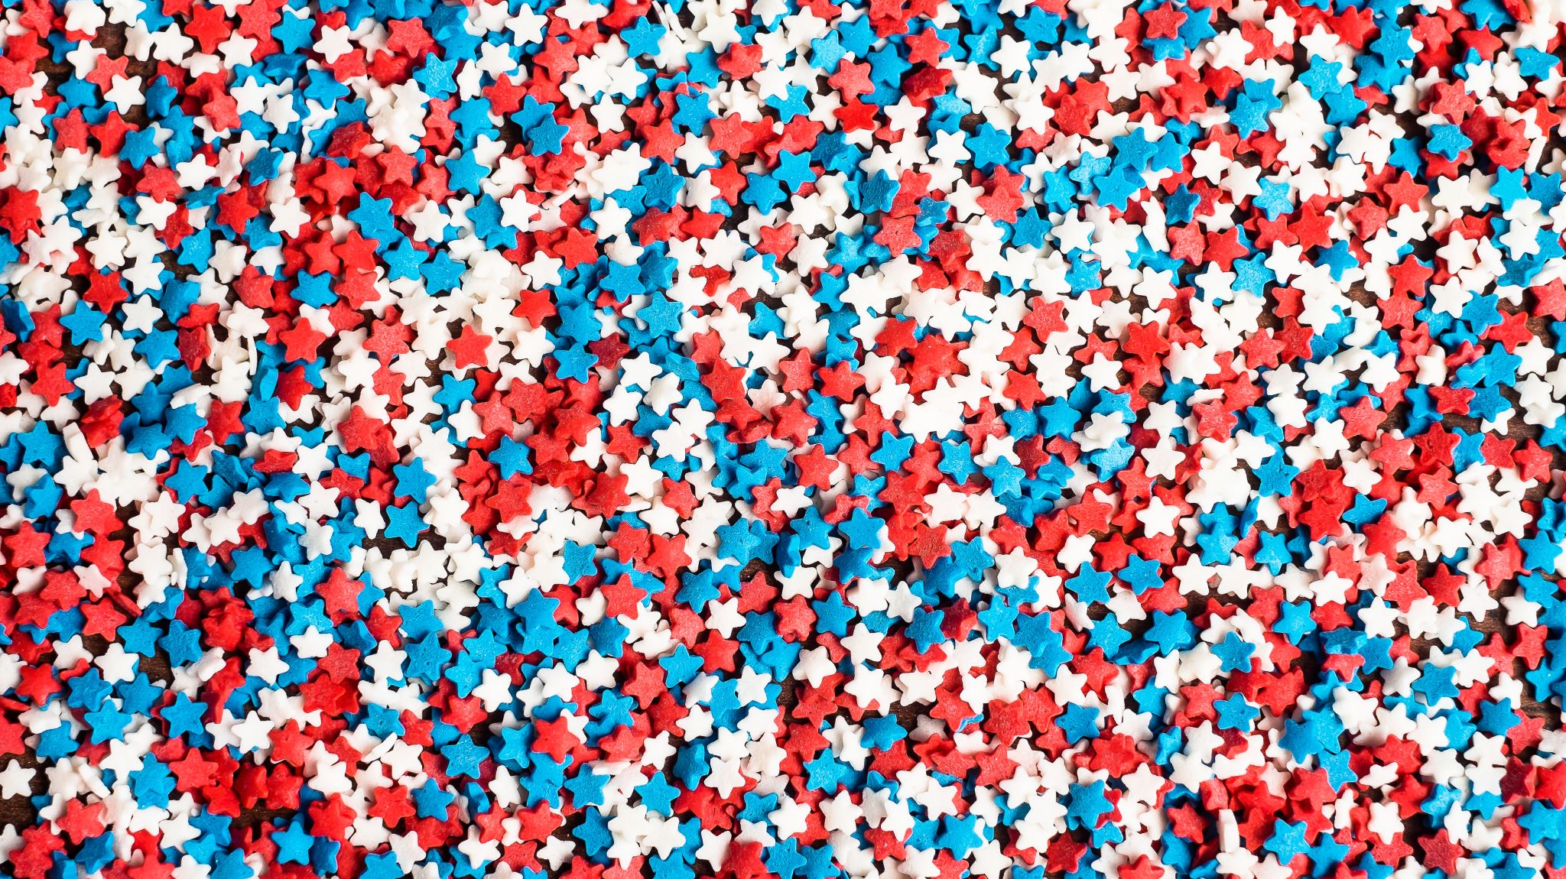
Dutch National Flag Algorithm
By: Yousef Alaa

Slide 2
The Problem
A recurring problem within the world of algorithms SORTING

Slide 3
The Strategy
Dutch national flag is considered a quicksort algorithm which means it uses the Divide and Conquer Strategy

Slide 4

The Implementation
Low values: on the left
High values: on the right
Middle values: Ignored😴

Slide 5
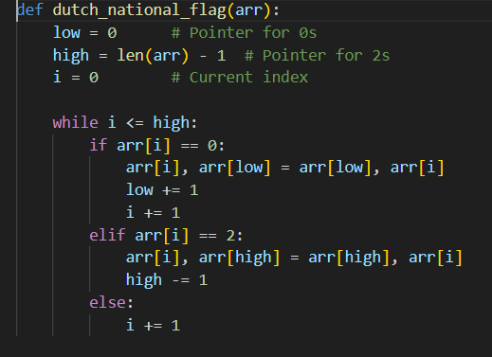
The Algorithm

Slide 6
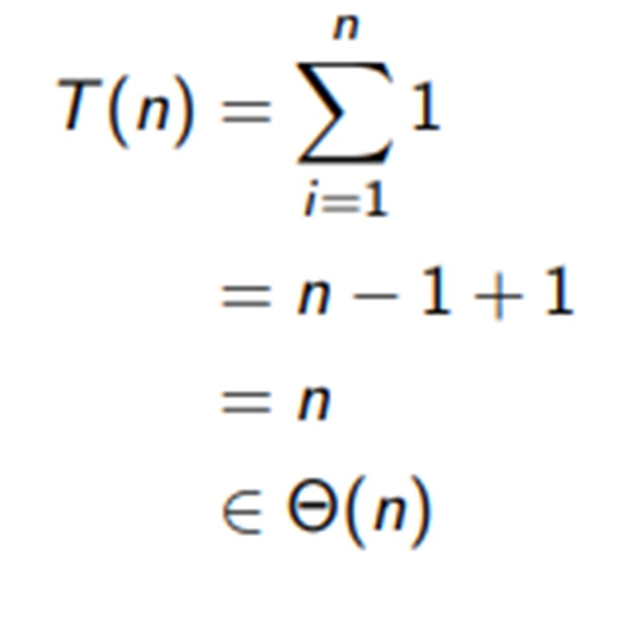
The Analaysis

